Slide 1
Exploring finite-sample bias in propensity score weights
LUCY D’AGOSTINO MCGOWAN
&
ROBERT GREEVY, JR.
Notes:
We’ve shown these exciting new weighting methods that have dispelled myths about propensity score weighting. Weighting is dangerous when it comes to unmeasured confounding – it is true that it is theoretically possible for weighting to make things worse – if that unmeasured confounder has some correlation, weighting does better than covariate adjustment alone
Misconceptions:
Weighting has finite sample problems
It is inefficient
It makes unmeasured confounding worse
WRONG-WRONG relative to OLS – increase correlation between X2 X1 – one effect size, but what we vary is the correlation

Slide 2
Overview
Finite sample bias
Unmeasured confounding – the problem
Unmeasured confounding – a solution
1
2
3
Notes:
This talk will have 3 main parts, the first part follows up nicely after Laine’s discussion of the ATO weights – we use a simulation setting from a paper published in 2008 that suggests that weighting provides biased estimates, even when the propensity score is correctly specified replicate these simulations to explore this finite sample bias using ATO and ATM weights
This simulation is under the setting where both a propensity model and an outcome model are fit, and as I mentioned the propensity score is correctly specified. We then examine what would happen under these simulation conditions if rather than correctly specifying the propensity score model, both models are misspecified – this introduces “the problem”
Finally, we demonstrate a potential solution to be able to get a handle on this potential for unmeasured confounding

Slide 3
treatment
control

Slide 4
trt
control
Notes:
The dark portion, the grey, are the propensity scores the top part of the mirrored histogram is the treated population and the bottom, the upside-down histogram is the control population. Then the green represents the weighted propensity scores for the treated and the blue is the weighted propensity scores for the controls.

Slide 5
trt
control
151
ATE
Notes:
The dark portion, the grey, are the propensity scores the top part of the mirrored histogram is the treated population and the bottom, the upside-down histogram is the control population. Then the green represents the weighted propensity scores for the treated and the blue is the weighted propensity scores for the controls.
- Frequency counts for a sudo population based on the weights
_click_ This guy at the far end has a propensity score greater than .99, and therefore ends up accounting for 151 people in the sudo cohort

Slide 6
treatment
control
1
ATM
Notes:
Population: based on the table 1, the exposed and unexposed in the weighted Table 1 will look like each other, but they will look different than the overall cohort – they will look like if you had done a matched cohort (1:1 matching)
This one person now is only representing 1 person in the sudo cohort, meanwhile the 20 treated people right above are each account for 1/20th of a person in the sudo cohort

Slide 7
treatment
control
ATO
Notes:
Population: will look a lot like a Table 1 from a 1:1 matched trial, but shifts a bit to improve the variance

Slide 8
ATE
ATM
AT0

Slide 9
ATE
ATM
AT0

Slide 10
ATE
ATM
AT0

Slide 11
Finite-sample bias

Slide 12
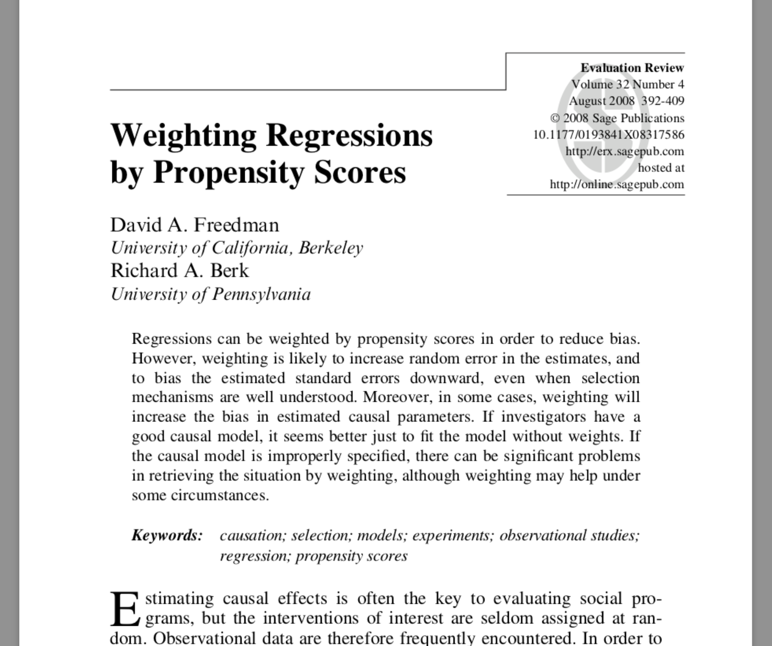
Notes:
This is one of the several papers has cast shade on IPW weighting that made us think that weighting is inherently flawed. We’re going to show that it is not inherently flawed
In their setting they have set it us such that they are fitting a propensity score model and and a weighted outcome model -- in the continuous case this is essentially a doubly robust estimator
They used ATE weights

Slide 13
Freedman & Berk Simulation

Slide 14
x₁
x₂
z
y

Slide 15
1
x₁
x₂
0.25
2
0.75
1
z
1
y

Slide 16
1
x₁
x₂
0.25
2
0.75
1
z
1
y

Slide 17
1
x₁
x₂
0.25
2
0.75
1
z
1
y

Slide 18
1
x₁
x₂
0.25
2
0.75
1
z
1
y

Slide 19
Propensity score model
x₁
x₂
z

Slide 20
Outcome model
x₁
x₂
z
y

Slide 21
treatment
ctrl

Slide 22
n = 1000
Notes:
At n = 1000, Freedman and Berk report a bias of 0.13 and we replicate this, we observing a bias of 0.14. Even when n is 10,000, the result is still biased. So they of course were correct, these weights do lead to bias in finite samples.

Slide 23
Notes:
However it turns out to be less of a story about weighting in general, and more of a story about these particular weights.

Slide 24
Standard errors

Slide 25
Outcome model
x₁
x₂
z
y

Slide 26
Notes:
We replicate what Freedman and Berk show, that this difference in the true standard error of these estimates is 0.12.

Slide 27
Notes:
Correct-correct
Minimum variance unbiased estimator

Slide 28
Recap
Replicated the finite-sample bias seen by Freedman and Berk using the ATE weights
ATM and ATO weights had improved finite-sample properties
The variance for the ATO and ATM is preferable to that of the ATE

Slide 29
Unmeasured confounding the problem
Notes:
10.25

Slide 30
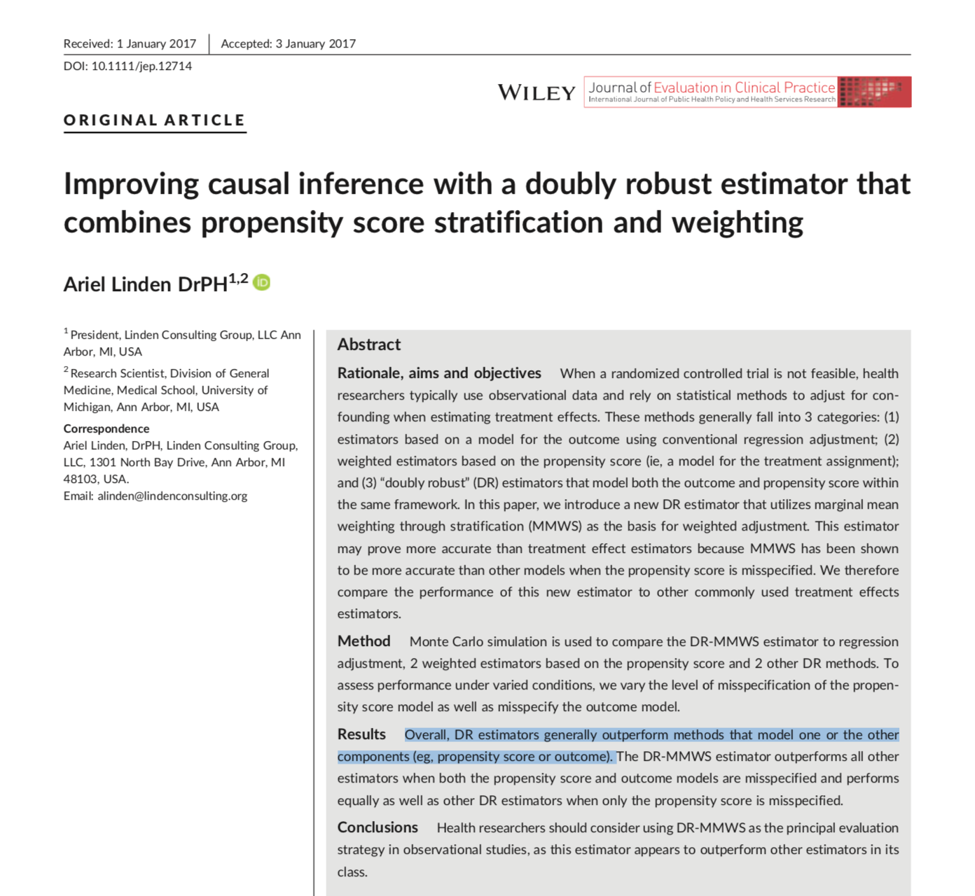
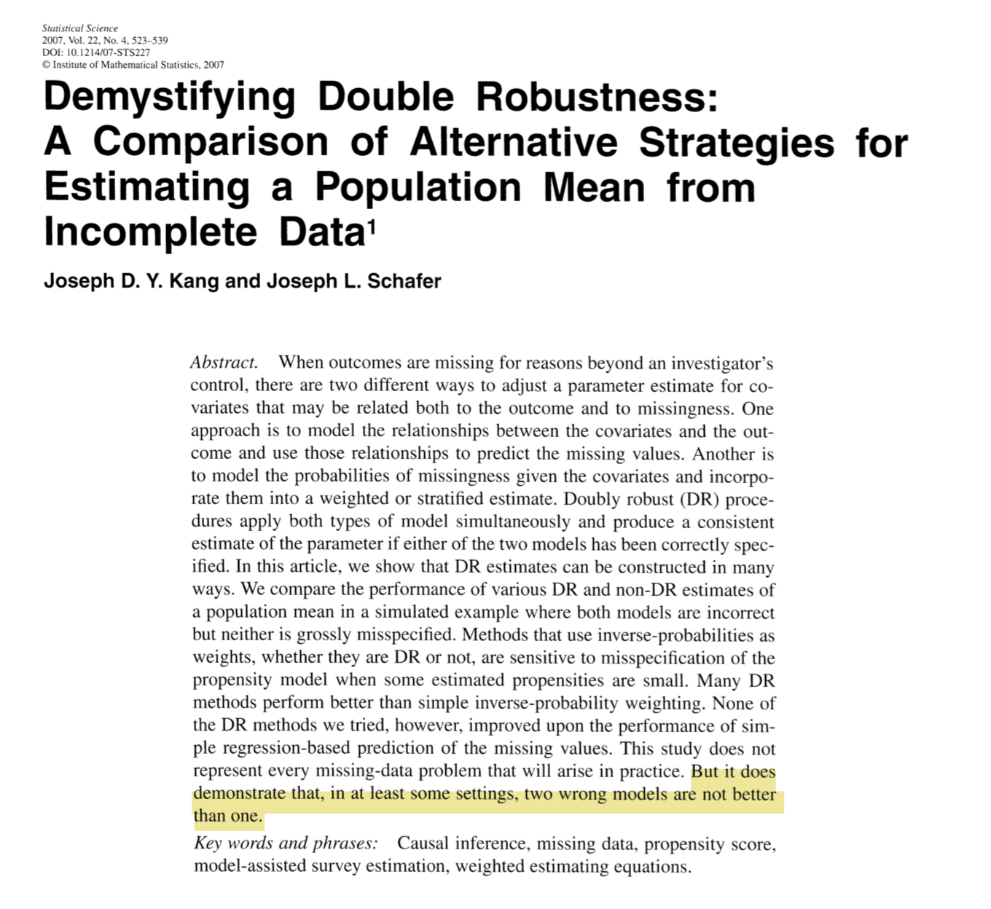
Notes:
The wisdom we've taken from these papers in rooted in teh ATE, we need to revisit this for these new weights

Slide 31
Propensity score model
x₁
x₂
z

Slide 32
Outcome model
x₁
x₂
z
y
Notes:
We varied the correlation between x1 and x2 to visualize how this impacts the bias observed

Slide 33
ATE

Slide 34
ATO
Notes:
show ATE first, then show ATO

Slide 35
Unmeasured confounding a solution
Notes:
We are excited about quantified and contextualized sensitivity analysis
5 minutes
16

Slide 36
E-value
$$E−value=LB_{obs}+\sqrt{LB_{obs}×(LB_{obs}−1)}$$
VanderWeele and Ding (2017)
Notes:
Vanderweele and Ding’s E-value answers a similar question as this quantified sensitivity analysis, it is the point that minimizes the strength of association, on the risk ratio scale, that an unmeasured confounder would need to have with both the exposure and outcome, conditional on the measured covariates, to explain away an observed exposure-outcome association. Again this is certainly one way to look at the analysis, but can be difficult contextualize without more information.

Slide 37

Adjusted E-value
$$E−{value}_{adj}=\frac{LB_{obs}}{LB_{adj}}+\sqrt{\frac{LB_{obs}}{LB_{adj}}×\left(\frac{LB_{obs}}{LB_{adj}}−1\right)}$$
Notes:
we’ve used similar methodology to create an adjusted e-value, where we allow you to input the value you are trying to adjust to, rather than always setting the adjusted limiting bound to one. I will demonstrate soon how we can use this with our observed covariates

Slide 38
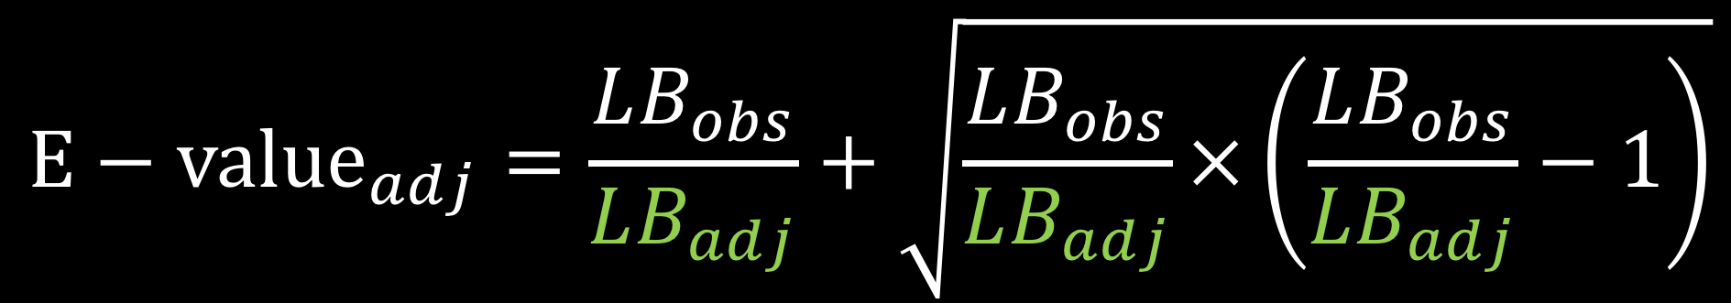
Adjusted E-value
$$E−{value}_{adj}=\frac{LB_{obs}}{LB_{adj}}+\sqrt{\frac{LB_{obs}}{LB_{adj}}×\left(\frac{LB_{obs}}{LB_{adj}}−1\right)}$$
Notes:
Rather than tipping to see where the lower bound crosses 1, we allow you to specify a value you’d like to tip to – this allows us calculate “observed e-values” for our measured covariates

Slide 39
Right Heart Catheterization Data
Connors et al (1996)
Notes:
This dataset is assessing the effectiveness of right heart catheterization (RHC) in the initial care of critically ill patients.
Publically available

Slide 40
Right Heart Catheterization data
We chose 20 covariates for demonstration purposes
demographics
comorbidities
physiological measurements
diagnosis categories
APACHE score
SUPPORT (probability of surviving 2 months)
DNR status on day 1
Connors et al (1996)
Notes:
We chose 20 covariates to include for demonstration purposes
Demographics
Comorbidities
Physiological measurements
Diagnosis categories
APACHE score
SUPPORT model estimate of the probability of surviving 2 months
DNR status on day 1

Slide 41
Right Heart Catheterization data
Fit a propensity score model
Use ATO weights
Fit weighted cox model for 30 day survival
Notes:
looking at relationship between 30 day survival and RHC

Slide 42
Notes:
I’m going to spend a minute on this plot -- this is a plot we’ve come up with that we’re calling an ”observed bias plot” the light blue shaded region shows the confidence interval for the observed exposure – outcome effect with all covariates included in the analysis, so here the effect between RHC and 30 day survival, in our case it is about (1.11 to 1.37). The blue line down the center is the observed point estimate, in this case it is a hazard ratio around 1.24. Each black line is the exposure-outcome effect that would have been observed had the covariate indicated not been observed. For example this top one here _click_ is the observed effect between RHC and 30 day survival if we had not observed DNR status on day 1 _click_. The purple stars represent the “adjusted E-values” These represent what the E-value would be if the *only* unmeasured confounder that were missing is the one that is dropped. So this E-value here _click_ represents what the E-value would be if DNR status on day 1 were the only missing covariate. This gives some contextualization to the E-value, allowing you to imagine it in the context of your observed covariates

Slide 43
Notes:
We also include additional values at the bottom _click_ where we can observe what happens if we leave out groups of variables, such as Labs or physiological measurements. This begins to get at the question “what if we are missing a lot of unmeasured confounders”. We then also plot what an unmeasured confounder that would tip the analysis at the Lower Bound and at the point estimate would look like, along with the associated E-value.

Slide 44
Notes:
Given the observed lower bound of 1.11, the associated E-value is 1.46. Examining Observed bias plot we can add some context to this value. The only associated E-value close to this is that for DNR status on day 1. This implies that we would need to be missing an additional independent covariate akin to DNR status on day 1 in order to tip our analysis. Even dropping all physiological measurements would not reach an E-value great enough to tip this study to inconclusive.

Slide 45


Thank you!
@LucyStats http://bit.ly/LucyStatsENAR2018 lucymcgowan.com

